Slide 1

ECE 220 Computer Systems & Programming
Lecture 3 – Repeated Code: TRAPs and Subroutines
September 3, 2019
MP1 due Thursday, 9/5, by 10pm
Schedule mock quiz for extra credit
Notes:
ECE Main Slide

Slide 2
Outline
Chapter 9
Repeated code: TRAPs and Subroutines
Key concepts
Lookup table: for starting address of subroutines/TRAPS (vector table)
Preserving register and PC values
Instructions
TRAP
RET
JSR, JSRR

Slide 3
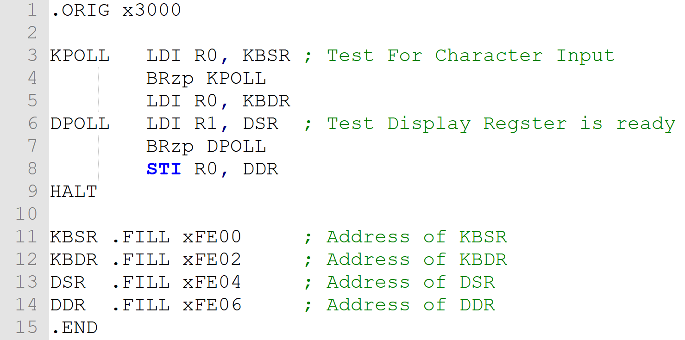
Last Class Example (memory Mapped I/O) - Requires knowledge of the hardware - One could mess up hardware registers

Slide 4
Solution: TRAP Service Routine
It is desirable to provide service routines or system calls (part of operating system) to safely and conveniently perform low-level, privileged operations
User program invokes system call
Operating system code performs operation
Returns control to user program

Slide 5
How to make this idea work?
User program invokes TRAP subroutine; OS code performs operation; Returns control to user program
The actual code of the service routine
Mechanism for invocation
TRAP Instruction, e.g., TRAP x23
TRAP vector (8 bits)
How to find address service routine?

Slide 6
TRAP Vector Table for LC3
vector | address | symbol | routine
…
x20 | x…. | GETC | read a single character (no echo)
x21 | x…. | OUT | output a character to the monitor
x22 | x…. | PUTS | write a string to the console
x23 | x…. | IN | print prompt to console, read and echo character from keyboard
X23 | x…. | PUTSP | write a string to the console; two chars per memory location
x25 | x…. | HALT | halt the program
…
Look-up table decouples names of subroutines (GETC) from the location of its implementation in memory

Slide 7
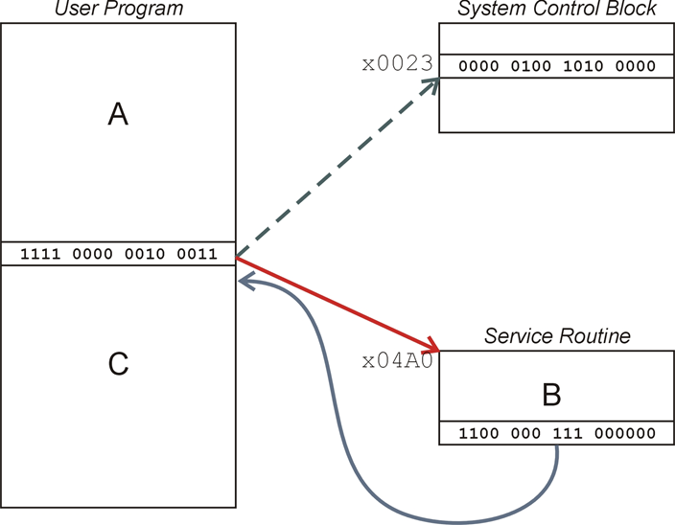
TRAP Mechanism

Slide 8
TRAP Mechanism
PC is loaded with the address of the first instruction of the corresponding service routine
MAR←ZEXT(trapvector)
MDR←MEM[MAR]
R7←PC (note that we save old PC in R7)
PC←MDR
Once the service routine is done, control is passed back to the user program suing RET instruction, which is just another name for JMP R7 instruction
PC←R7 (restore old PC to return to the user program)
must make sure that service routine does not change R7, or we won’t know where to return
also, must make sure R7 does not have a useful value that will be overwritten in the process of calling a TRAP

Slide 9
What do we need to make this work?
User program invokes or calls subroutine; OS code performs operation; Returns control to user program
Address | Contents | Comments
x0000 |  | ;system space;
X0023 | x04A0 | ; Trap vector table
x00FF |  | ; End of trap vector table
x04A0 |  | ; code for IN
….
x04… |  | ; code for OUT
…
x3000 |  | ; user program
…
 | TRAP x23 | ; call to
xFE00 |  | ; Device registers
The actual code of the service routine
Mechanism for invocation
TRAP Instruction, e.g., TRAP x23
TRAP vector
MAR ←ZEXT[trapvector]
MDR ←MEM[MAR]
PC←MDR
How to return to user program after execution of OUT completes?

Slide 10
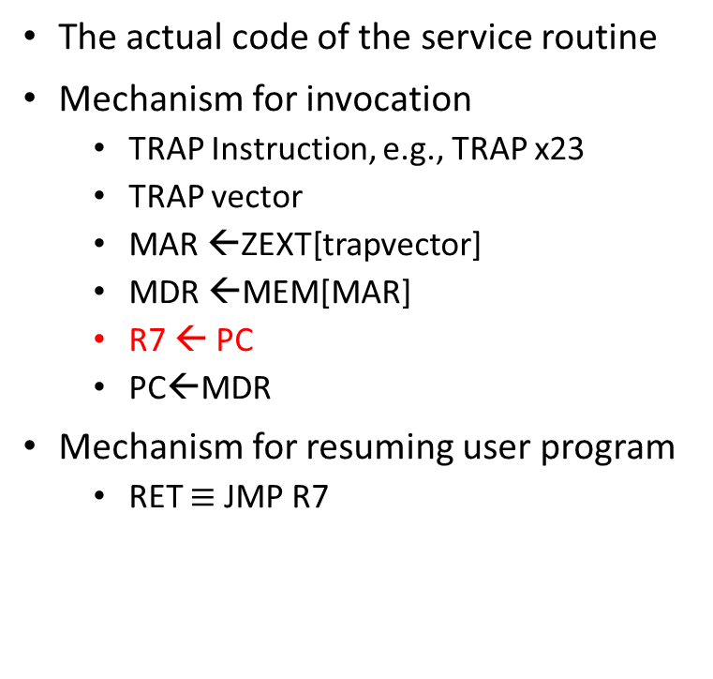
What do we need to make this work?
User program invokes TRAP service routine; OS code performs operation; Returns control to user program
Address | Contents | Comments
x0000 |  | ;system space;
x0023 | x04A0 | ; Trap vector table
x00FF |  | ; End of trap vector table
x04A0 |  | ; code for IN
…. | RET
x04.. |  | ; code for OUT
…
x3000 |  | ; user program
…
 | TRAP x23 | ; call to
xFE00 |  | ; Device registers
The actual code of the service routine
Mechanism for invocation
TRAP Instruction, e.g., TRAP x23
TRAP vector
MAR ←ZEXT[trapvector]
MDR ←MEM[MAR]
R7 ← PC
PC←MDR
Mechanism for resuming user program
RET $≡$ JMP R7

Slide 11
Putting it all together: 4 Things make TRAPs work
TRAP instruction
used by program to transfer control to OS subroutines
8-bit trap vector names one of the 256 subroutines
Trap vector table: stores starting addresses of OS subroutines
stored at x0000 through x00FF in memory
A set of OS subroutines
part of operating system -- routines start at arbitrary addresses (convention is that system code is below x3000) up to 256 routines
A linkage back to the user program (RET)
want execution of the user program to resume immediately after the TRAP instruction

Slide 12
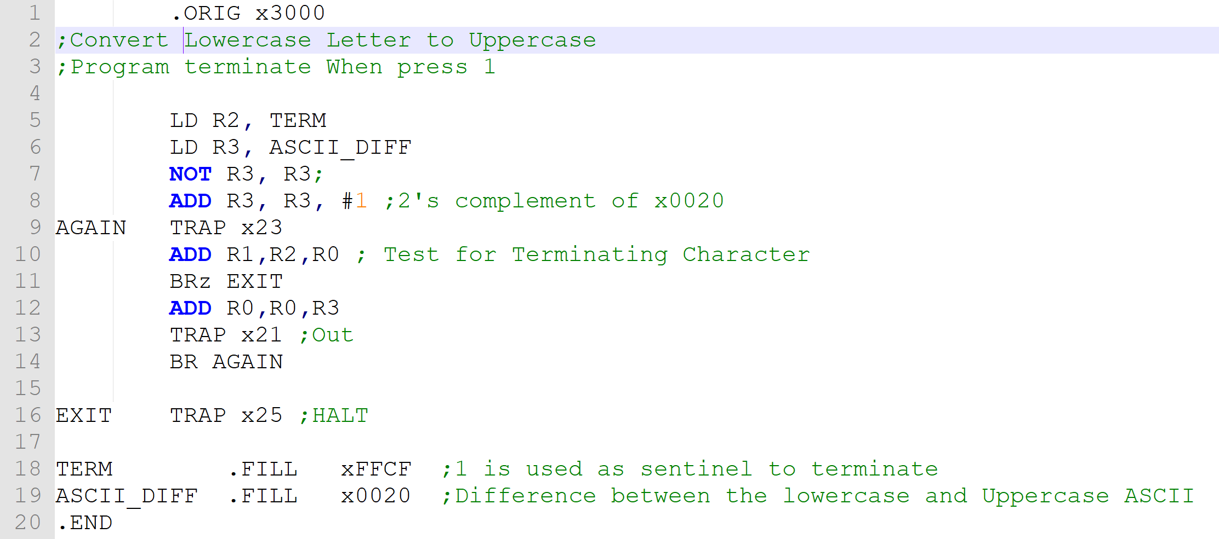
Example: Convert lowercase input characters to uppercase characters. The program uses a sentinel of 1 to terminate the program
Please see the Modified version (which check invalid inputs) posted on Github

Slide 13
TRAP Example (Needs special attention)
.ORIG x3000
AND R0, R0, #0
ADD R0, R0, #5 ;init R0 and set it to 5
LD R7, COUNT ;Initialize to 10
IN ;same as ‘TRAP x23’
ADD R0, R0, #1 ;increment R0
ADD R7, R7, #-1 ;decrement COUNT
HALT
.END
COUNT .FILL #10
Question: What could go wrong?
What are the values in R0 and R7 before and after IN statement?
6

Slide 14
Suggested approach:
Caller of service routine can save (and restore): Caller-save
Called service routine saves (and restore): Callee-save
Saving and restoring values of registers is an example of a task computers need to perform in context switching
; Caller-save user program
…
ST R0, SaveR0 ; store R0 in memory
ST R7, SaveR7 ; store R7 in memory
IN ; call TRAP which ; destroys R0 and R7
LD R7, SaveR7 ; restore R7
… ; consume input in R0
LD R0, SaveR0 ; restore R0
…
HALT
SaveR0 .BLKW 1
SaveR7 .BLKW 1
Notes:
Caller knows what is important
Callee knows what damage will be done

Slide 15
What do we need to make this work? (3RD Edition Book)
User program invokes TRAP service routine; OS code performs operation; Returns control to user program
The actual code of the service routine
Mechanism for invocation
Fetch TRAP Instruction, e.g., TRAP x23
System Stack ← PC, PSR
PSR[15] is set to zero and save R6 and load R6 ← content of Saved_SSP
MAR ←ZEXT[trapvector]
MDR ←MEM[MAR]
PC←MDR
Mechanism for resuming user program
RTI
-pops the two values of system stack into PC and PSR.
- Check PSR[15] and R6 is restored accordingly
Address | Contents | Comments
x0000 |  | ;system space;
x0023 | x04A0 | ; Trap vector table
x00FF |  | ; End of trap vector table
x04A0 |  | ; code for IN
…. | RTI
x04.. |  | ; code for OUT
…
x3000 |  | ; user program
…
 | TRAP x23 | ; call to
xFE00 |  | ; Device registers

Slide 16
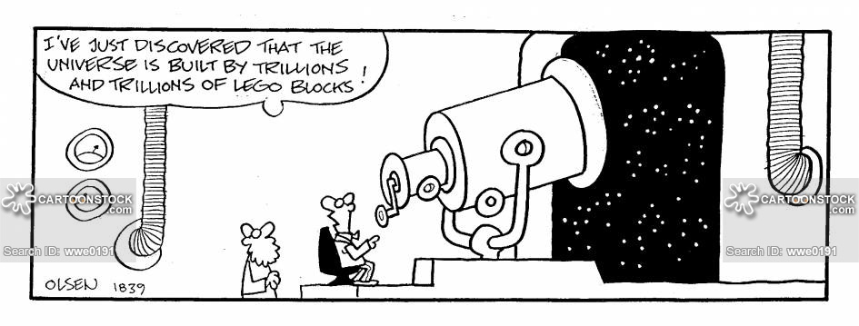
Key Concept: Abstraction

Slide 17
Observation
start
Get input R3 ← MEM[x4000]
R4 ← X²
Multiply
Example problem: Compute y=3x³-6x²+7x for any input x > 0
Programs have lots of repetitive code fragments
R5 ← X³
Multiply
R5 ← 3X³
Multiply
R4 ← 6X²
Multiply
R3 ← 7X
Multiply
R6 ← 3X³ - 6X²
Add
; multiply R0 ←R1 * R2
MULT AND R0, R0, #0 ; R0 = 0
LOOP ADD R0, R0, R2 ; R0 = R0 + R2
ADD R1, R1, #-1 ; decrease counter
BRp LOOP
R6 ← (3X³ - 6X²) + 7x
Add
Store output
stop

Slide 18
Implementation Option
start
Issues ?
Get input R3 ← MEM[x4000]
;; LC-3 Assembly Program
.ORIG x3000
LDI R3, Xaddr; R3 ← x
ADD R1, R3, #0;
; Multiply R4 ← R1 * R3 x²
...
...
; Multiply R5 ← R4 * R3 x³
...
; Multiply R5 ← R5 * 3 (3x³)
...
; Multiply R4 ← 6 * R4
R4 ← X²
Multiply
R5 ← X³
Multiply
R5 ← 3X³
Multiply
R4 ← 6X²
Multiply
R3 ← 7X
Multiply
R6 ← 3X³ - 6X²
Add
R6 ← (3X³ - 6X²) + 7x
Add
Store output
stop
*Sometimes programs are compiled to look like this for better performance: inline functions

Slide 19
Subroutines
A sequence of instructions that performs a specific task (and nothing else---no side effects). This unit can then be used in programs wherever that particular task should be performed.
Hide details of code and package them with an interface
Abstract away details
Needs only Arguments and return values
Why is this a good idea in programming?
Reuse; shorter programs
Simplify; code comprehension
Teamwork; allows multiple developers to work on different pieces; libraries
TRAPs are examples of OS subroutines

Slide 20
Idea
User invokes or calls subroutine
Subroutine code performs operation / task
Returns control to user program with no other unexpected changes
input
My program
Piece of code / Subroutine / Trap service routine
output

Slide 21
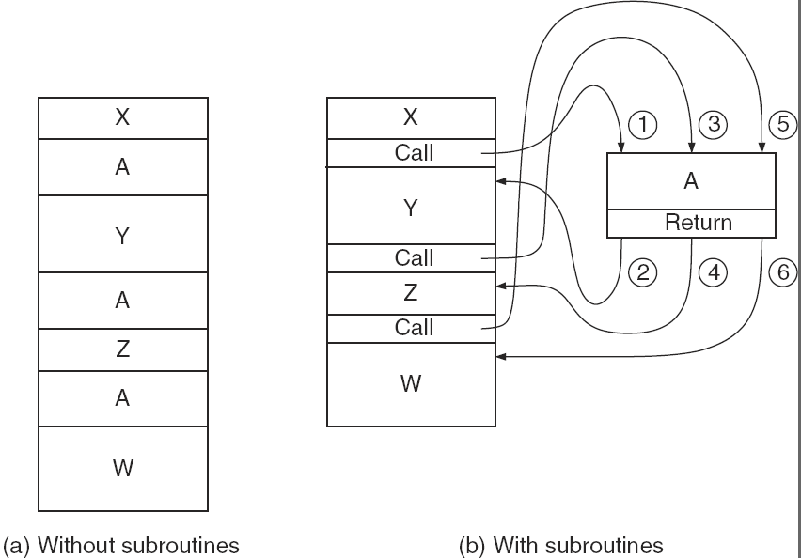
Figure 9.7

Slide 22
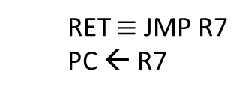
JSR and JSRR
R7←PC
If (IR[11] == 0) PC←BaseR
Else PC←PC+SEXT(IR[10:0])
RET $≡$ JMP R7
PC ← R7

Slide 23
JSR and JSRR and RET
JSR:
R7 <- PC;
PC <- PC + SEXT(PCOffset11);
JSRR:
R7 <- PC;
PC <- BaseR;
RET:
PC <- R7;

Slide 24
Subroutine Examples
Can you find the bugs in the following piece of code?
; SUBTR subroutine computes difference of two 2’s complement numbers
; IN: R1, R2
; JSR SUBTR
OUT: R0 <- R1-R2
SUBTR NOT R2, R2
ADD R7, R2, #1
ADD R0, R1, R7
RET
12

Slide 25
Subroutine Examples
Can you find the bugs in the following piece of code?
; SUBTR subroutine computes difference of two 2’s complement numbers
; IN: R1, R2
; JSR SUBTR
OUT: R0 <- R1-R2
SUBTR NOT R2, R2
ADD R7, R2, #1
ADD R0, R1, R7
RET
Issues with this implementation
Argument in R2 will be changed on exit
Fix: save/restore R2 in the subroutine
R7 value is modified in the subroutine, thus, we will not be able to return from it
Fix: do not use R7, or save/restore it in the subroutine
If R7 holds a useful value in the main program, it will be overwritten during the subroutine call
Fix: save/restore R7 in the main program
If SUBTR is located far enough in the memory from the point where it is called, we may not be able to reach it with JSR instruction
Fix: use JSRR instruction instead
12

Slide 26
Implementation (Code is on Github)
start
Get input R3 ← MEM[x4000]
;; LC-3 Assembly Program
.ORIG x3000
LDI R3, Xaddr; R3 ← x
ADD R1, R3, #0;
; Multiply R4 ← R1 * R3 x²
...
...
; Multiply R5 ← R4 * R3 x³
...
; Multiply R5 ← R5 * 3 (3x³)
...
; Multiply R4 ← 6 * R4
R4 ← X²
Multiply
R5 ← X³
Multiply
R5 ← 3X³
Multiply
R4 ← 6X²
Multiply
R3 ← 7X
Multiply
R6 ← 3X³ - 6X²
Add
R6 ← (3X³ - 6X²) + 7x
Add
Store output
stop
*Sometimes programs are compiled to look like this for better performance: inline functions

